Slide 1
Communication

Slide 2
System Architecture & Communication
System Architectures
Processes
Communication in a Distributed System
Communication Abstractions

Slide 3
BUILDING A DISTRIBUTED SYSTEM
Placing the hardware.
Placing the software.
“Logical organization of components”

Slide 4
ARCHITECTURE
Software Architecture of Distributed System:
  It deals with how software components are organised and,
  how they work together, i.e., communicate with each other.
  Typical software architectures include:
    layered,
    object-oriented,
    data-centred,
    and event-based
Software architectures

Slide 5
Contd…
System Architecture:
describe the placement of software components on physical machines
  The realization of an architecture may be centralized (most components located on a single machine), decentralized (most machines have approximately the same functionality), or hybrid (some combination).
There is no single best architecture:
The best architecture for a particular system depends on the application requirements and the environment.

Slide 6
Architectural Styles
An architectural style describes a particular way to configure a collection of components and connectors.
  Component - a module with well-defined interfaces; reusable, replaceable
  Connector – communication link between modules

Slide 7
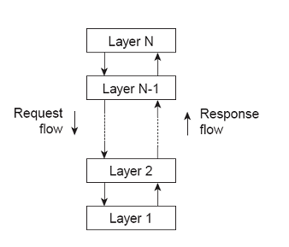
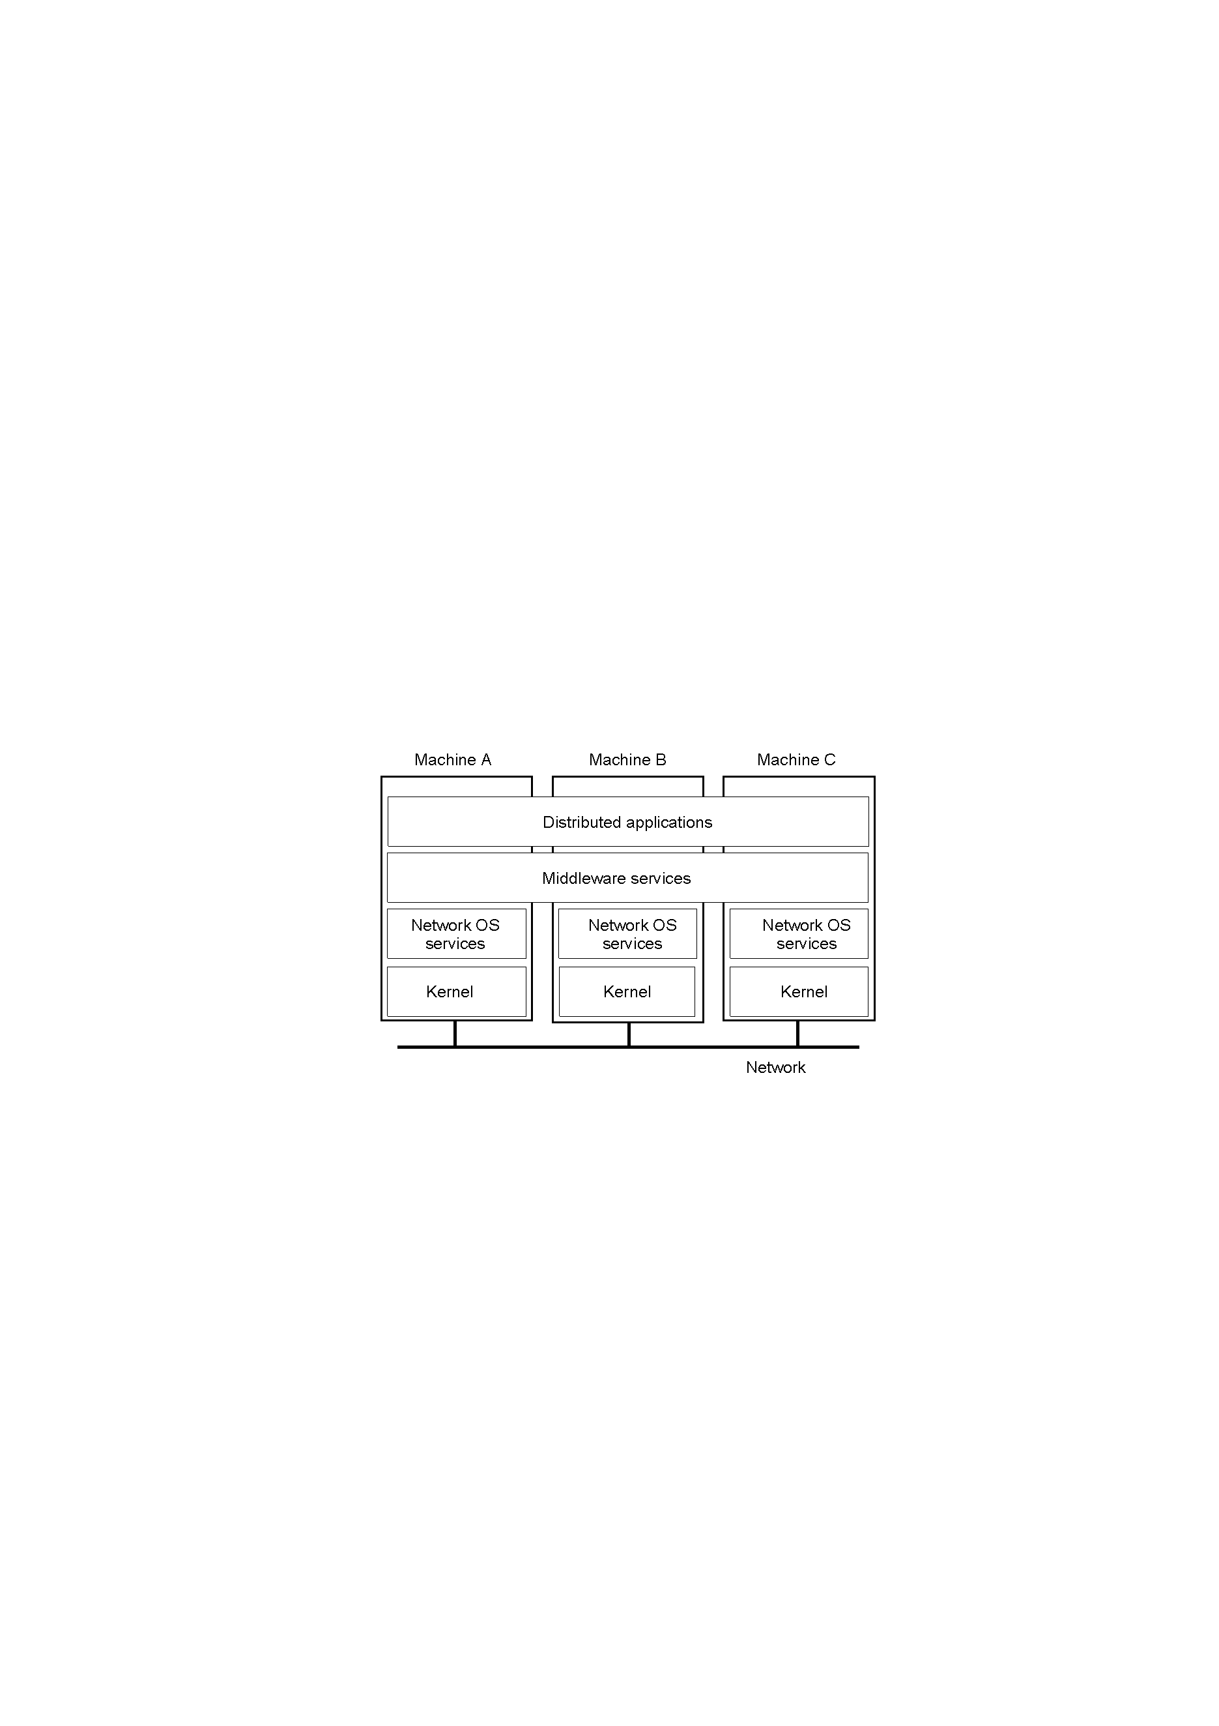
Architectural styles(1/4): Layered style
Observation: Layered style is used for client-server system.

Slide 8
Contd…
Components at layer L_{N} are allowed to call components at underlying layers L_{N-1}, but not the other way around.
User Interface Layer
Applications Layer
Requests
Results
Data Management Layer
Database Layer

Slide 9
Architectural styles (2/4): object based
Basic idea: Organize into logically different components, and subsequently distribute those components over the various machines.
Observation: object-based style for distributed object systems.
In essence, each object corresponds to what we have defined as a component and
these components are connected through a (remote) procedure call mechanism.
Object
Object
Object
Method Calls
Object
Object
component = object
connector = RPC or RMI

Slide 10
Architectural styles (3/4): data-centered
Main purpose: data access and update
Processes interact by reading and modifying data in some shared repository (active or passive)
  Traditional database (passive): responds to requests
  Blackboard system (active): system updates clients when information changes.

Slide 11
Architectural Styles (4/4): event-based
Processes communicate through event propagation
  ‘Publish/Subscribe’ systems
    Processes subscribed to events will receive them.
Benefit is, components are loosely coupled;
  i.e. they don’t need to explicitly refer to each other.

Slide 12
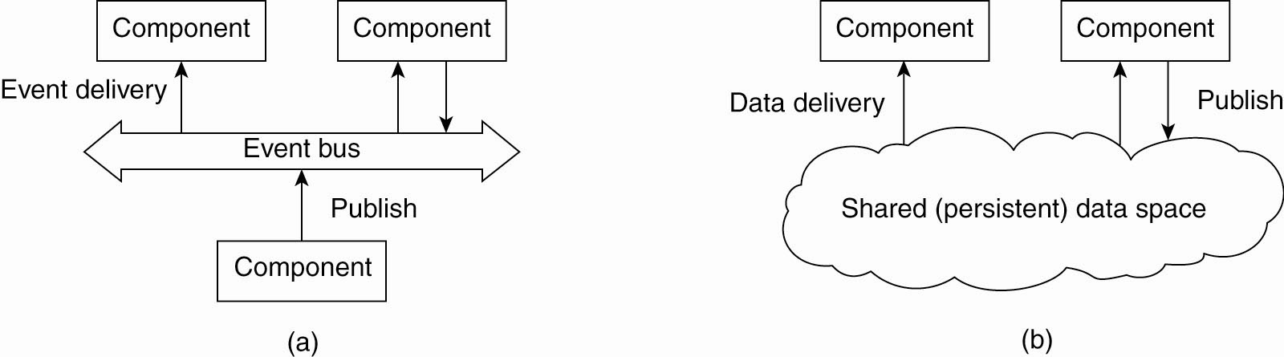
Contd…
In dist. Systems communication often in Publish/ Subscribe; e.g., register interest in market info; get email updates
Decouples sender & receiver; asynchronous communication
Event-based arch.
supports several communication styles:
Publish-subscribe
Broadcast
Point-to-point
Figure (a) The event-based architectural style

Slide 13
Contd…
Data Centric Architecture; e.g., shared distributed file systems
Combination of data-centered and event based architectures
Processes communicate asynchronously
Figure (b) The shared data-space architectural style.

Slide 14
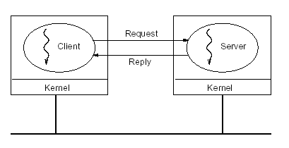
CLIENT-SERVER

Slide 15
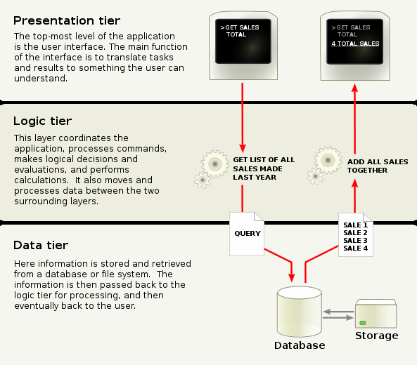
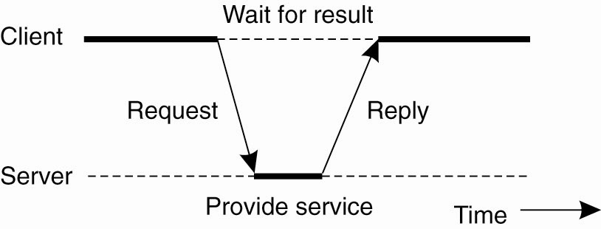
Client-Server from another perspective
A typical client-server application can be decomposed into three logical parts: the interface part, the application logic part, and the data part.
Implementations of the client-server architecture vary with regards to how the parts are separated over the client and server roles.

Slide 16
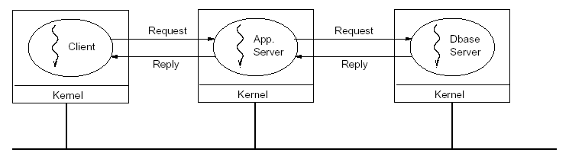
VERTICAL DISTRIBUTION (MULTI-TIER) splitting up a server’s functionality over multiple computers
The vertical distribution, or multi-tier, architecture distributes the traditional server functionality over multiple servers. A client request is sent to the first server.
Three layers’ of functionality:
User interface
Processing/Application logic
Data
Splitting up the server functionality in this way is beneficial to a system’s scalability as well as its flexibility.
Scalability is improved because the processing load on each individual server is reduced, and the whole system can therefore accommodate more users.
Logically different components on different machines

Slide 17
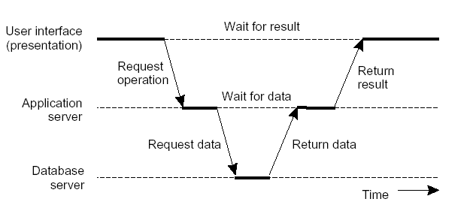
Vertical Distribution from another perspective

Slide 18
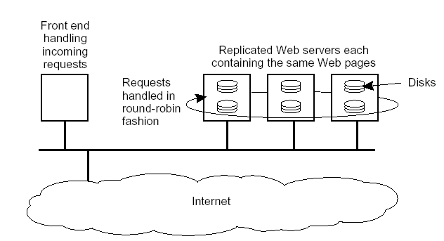
HORIZONTAL DISTRIBUTION replicating a server’s functionality over multiple computers
In this case, each server machine contains a complete copy of all hosted Web pages and client requests are passed on to the servers in a round robin fashion.
The horizontal distribution architecture is generally used to improve scalability (by reducing the load on individual servers) and reliability (by providing redundancy).
Logically equivalent components replicated on different machines

Slide 19
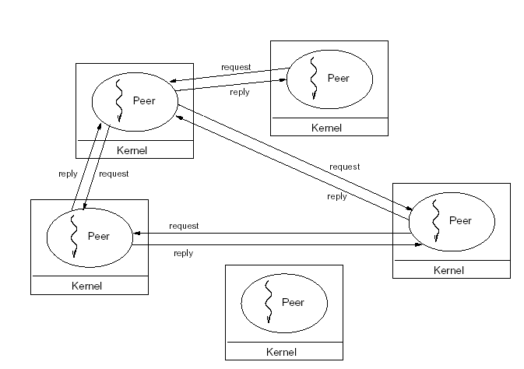
PEER TO PEER COMMUNICATION ARCHITECTURE
All processes have client and server roles.
With the potentially huge number of participating nodes in a peer to peer network, it becomes practically impossible for a node to keep track of all other nodes in the system and the information they offer.

Slide 20
OVERLAY NETWORKS
How do peers keep track of all other peers?
Overlay networks connect nodes in the P2P system
  Nodes in the overlay use their own addressing system for storing and retrieving data in the system
  Nodes can route requests to locations that may not be known by the requester.
Overlay Network
    Unstructured
    Structured

Slide 21
UNSTRUCTURED OVERLAY
Data stored at random nodes.
Exchange partial views with neighbours to update.
Partial view: which means that a node partial view consists of a random list of other nodes.

Slide 22
STRUCTURED OVERLAY
The node’s neighbours is determined according to a specific structure.
Nodes have identiﬁer and range.
Node is responsible for data that falls in its range.
Search is routed to appropriate node.

Slide 23
Comparison
Structured networks typically guarantee that if an object is in the network it will be located in a bounded amount of time.
Unstructured networks offer no guarantees.
  For example, some will only forward search requests to a specific number of hops

Slide 24
HYBRID ARCHITECTURES
Combination of architectures:
Examples:
Super peer networks
Collaborative distributed systems

Slide 25
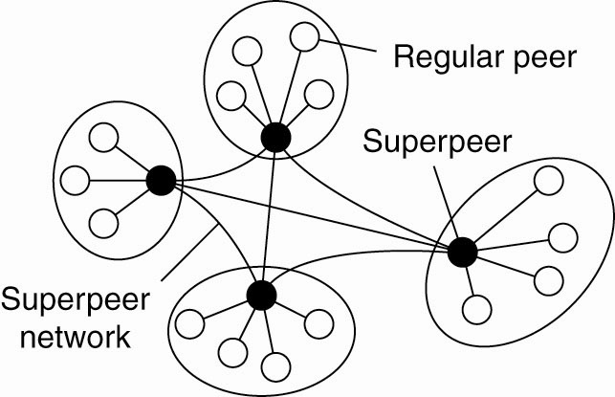
Superpeer Networks
In this architecture a few superpeers form a peer to peer network, while the regular peers are clients to a superpeer.
Superpeers managing the index of the regular peers
Act as servers to regular peer nodes, peers to other superpeers
Improve scalability

Slide 26
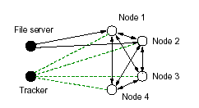
Collaborative Distributed Systems
In collaborative distributed systems, peers typically support each other to deliver content in a peer to peer like architecture, while they use a client server architecture for the initial setup of the network.
Nodes requesting to download a file from a server first contact the server to get the location of a tracker.
Tracker keeps track of active nodes that have chunks of file.
Using information from the tracker, clients can download the file in chunks from multiple sites in the network.
Nodes must then offer downloaded chunks to other nodes and are registered with the tracker, so that the other nodes can find them.

Slide 27
PROCESSES AND THREADS
A process, in the simplest terms, is an executing program.
One or more threads run in the context of the process.
Sometimes threads are also referred to as lightweight processes because they take up less operating system resources than regular processes.
A thread is the basic unit to which the operating system allocates processor time.
A thread can execute any part of the process code, including parts currently being executed by another thread.

Slide 28
PROCESSES AND THREADS
Some systems provide only a process model, while others provide only a thread model. More common are systems that provide both threads and processes. In this case each process can contain multiple threads, which means that the threads can only freely access the memory of other threads in the same process.
A server process in a distributed system typically receives many requests for work from various clients, and it is important to provide quick responses to those clients. In particular, a server should not refuse to do work for one client because it is blocked while doing work for another client. This is a typical result of implementing a server as a single-threaded process.
Alternatives to this are to implement the server using multiple threads, one of which acts as a dispatcher, and the others acting as workers.

Slide 29
STATEFUL VS STATELESS SERVERS
Stateful:
Keeps persistent information about clients
Improved performance
Expensive recovery
Must track clients
Stateless:
Does not keep state of clients
Soft state design: limited client state
Can change own state without informing clients
Increased communication

Slide 30
COMMUNICATION
In distributed system processes running on separate computers cannot directly access each other’s memory.
Two approaches to communication:
Shared memory-processes must have access to some form of shared memory (i.e., they must be threads, they must be processes that can share memory, or they must have access to a shared resource, such as a file)
In DSM the processes on separate computers all have access to the same virtual address space. The memory pages that make up this address space actually reside on separate computers.
Message passing- processes to communicate by sending each other messages

Slide 31
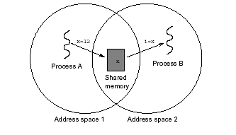
Shared Memory
Shared Memory:
There is no way to physically share memory
Distributed Shared Memory

Slide 32
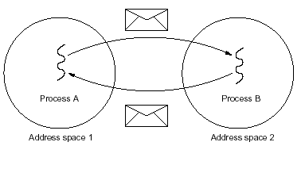
Message Passing
Message Passing:
Over the network
Introduces higher chances of failure
Heterogeneity introduces possible incompatibilities

Slide 33
COMMUNICATION MODES
Data oriented vs control oriented communication
Synchronous vs asynchronous communication
Transient vs persistent communication

Slide 34
Data-Oriented vs Control-Oriented Communication
Data-oriented communication
Facilitates data exchange between threads
Control-oriented communication
Associates a transfer of control with every data transfer
remote procedure call (RPC) & remote method invocation (RMI)
Observation:
Hardware and OSes often provide data-oriented communication
Higher-level infrastructure often provides control-oriented communication – middleware

Slide 35
Synchronous vs Asynchronous Communication
Synchronous:
Sender blocks until message received
• Often sender blocked until message is processed and a
reply received
Sender and receiver must be active at the same time
Client-Server generally uses synchronous communication
Asynchronous:
Sender continues execution after sending message (does not block waiting for reply)
Message may be queued if receiver not active
Message may be processed later at receiver’s convenience
When is Synchronous suitable? Asynchronous?

Slide 36
Transient vs Persistent Communication
Transient:
Message discarded if cannot be delivered to receiver immediately
a message will only be delivered if a receiver is active. If there is no active receiver process (i.e., no one interested in or able to receive messages) then an undeliverable message will simply be dropped.
Example: HTTP request
Persistent
A message will be stored in the system until it can be delivered to the intended recipient.
Example: email

Slide 37
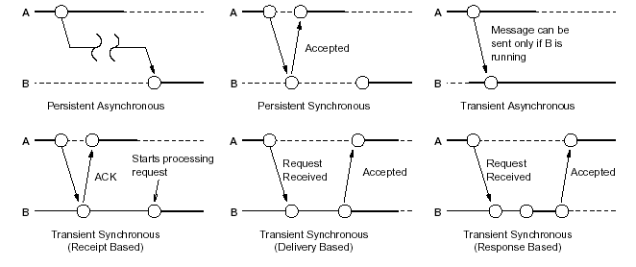
Possible combinations of synchronous/asynchronous and transient/persistent communication

Slide 38
COMMUNICATION ABSTRACTIONS
Number of communication abstractions that make writing distributed applications easier.
Provided by higher level APIs:
Remote Procedure Call (RPC)
Remote Method Invocation (RMI)
Message-Oriented Communication
Group Communication
Streams

Slide 39
REMOTE PR OCEDURE CALL (RPC)
Idea: allows a computer program to cause a subroutine or procedure to execute in another address space (commonly on another computer on a shared network).
Synchronous - based on blocking messages
Message-passing details hidden from application
Procedure call parameters used to transmit data
Client calls local “stub” which does messaging and marshaling

Slide 40
REMOTE METHOD INVOCATION (RMI)
The transition from Remote Procedure Call (RPC) to Remote Method Invocation (RMI) is a transition from the server metaphor to the object metaphor.
Why is this important?
Using RPC: programmers must explicitly specify the server on which they want to perform the call.
Using RMI: programmers invoke methods on remote objects.
More natural resource management and error handling

Slide 41
MESSAGE-ORIENTED COMMUNICATION:
MESSAGE-ORIENTED MIDDLEWARE (MOM)
Message-oriented communication is provided by message-oriented middleware (MOM).
Middleware support for message passing:-
Asynchronous or Synchronous communication
Persistent or Transient messages
Various combinations of the above
What more does it provide than send()/receive()?
Persistent communication (Message queues)
Hides implementation details
Marshaling (packing of function parameters into a message packet)

Slide 42
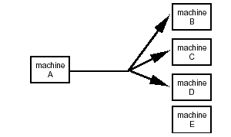
GROUP COMMUNICATION
Sender performs a single send()

Slide 43
GROUP COMMUNICATION………..
Two kinds of group communication:
  Broadcast (messgae sent to everyone)
  Multicast (message sent to specific group)
Used for:
  Replication of services
  Replication of data
  Service discovery
Issues:
  Reliability
  Ordering
Example:
  IP multicast

Slide 44
STREAMS
Support for Continuous Media
Between applications
Between devices
Data represented as single stream rather than discrete chunks

Slide 45
SUMMARY
Architectures
  Client-server (and multi-tier)
  Peer to peer
  Hybrid architectures
Processes in distributed systems
Communication modes (data oriented vs control oriented, synchronous vs asynchronous, transient vs persistent)
Communication Aastractions
  RPC and RMI
  Message-oriented communication
  Group communication (multicast)
  Streams

Slide 46
Appendix:
Internet Group Management Protocol
IP protocol can be involved in two types of communication: unicasting and multicasting. Multicasting has many applications. For example, multiple stockbrokers can simultaneously be informed of changes in a stock price.
IGMP is a protocol that manages group membership. The IGMP protocol gives the multicast routers information about the membership status of hosts (routers) connected to the network. .

Slide 47
Note:
IGMP is a group management protocol. It helps a multicast router create and update a list of loyal members related to each router interface.

Slide 48
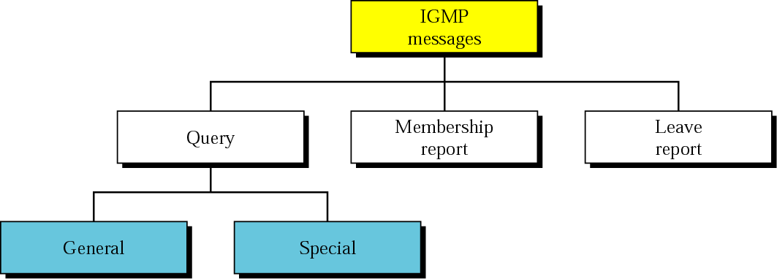
IGMP message types

